Slide 1


Slide 2
Agenda
12:30 Lunch - introductions
1pm Recap
Looking ahead
Group discussion
Summary
2:30pm End

Slide 3
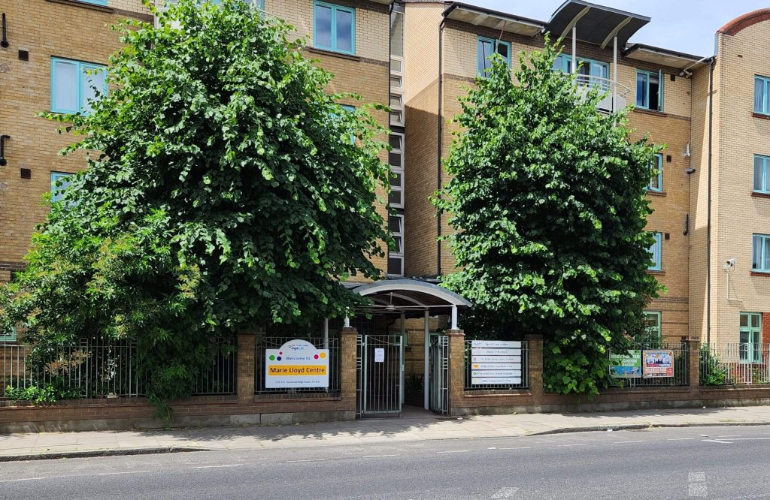
Who we are
Officially recognised Parent Carer Forum for Hackney (0–25 SEND)
Led by parents and carers, for parents and carers
Hosted by City & Hackney Carers Centre
Affiliated with the National Network of Parent Carer Forums
Bringing lived experience into local, regional and national SEND decision-making
Working in partnership with education, health, housing and the local authority
https://hspcf.org/join-hackney-parent-carer-forum/
Notes:
Explain the role of the PCF – what it can and cannot do

Slide 4

Our Aims

Slide 5
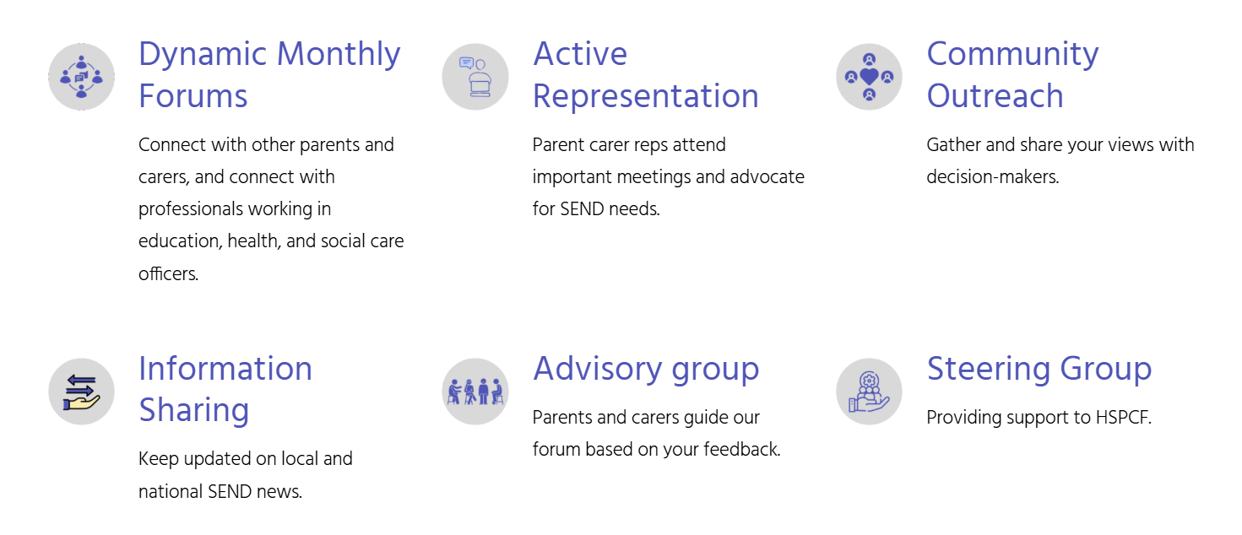
What we do

Slide 6
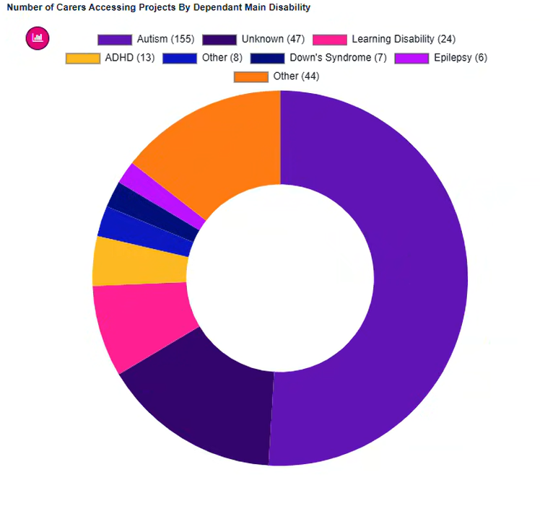
Needs of children
Autism
Unknown and other
Learning Disability
ADHD
Downs Syndrome
Epilepsy

Slide 7
Jan 2025-Jan 2026
Strong Foundations, Influencing change
Approximately doubled membership to 274 members
Approximate number of parent carers in Hackney 10K

Slide 8
Highlights
Active involvement in:
  SEND Strategic Partnership Board
  SEND & Inclusion Strategy development
  PfA Working Group meetings
  Local Area SEND Inspection engagement
  Submitted evidence to Parliament’s Solving the SEND Crisis inquiry
  Increased parent involvement in commissioning, transport and leadership decisions

Slide 9

Event Highlights
Regular steering group meetings
9 Coffee Morning events
Family Fun day
Hackney speaker events
Christmas gathering

Slide 10
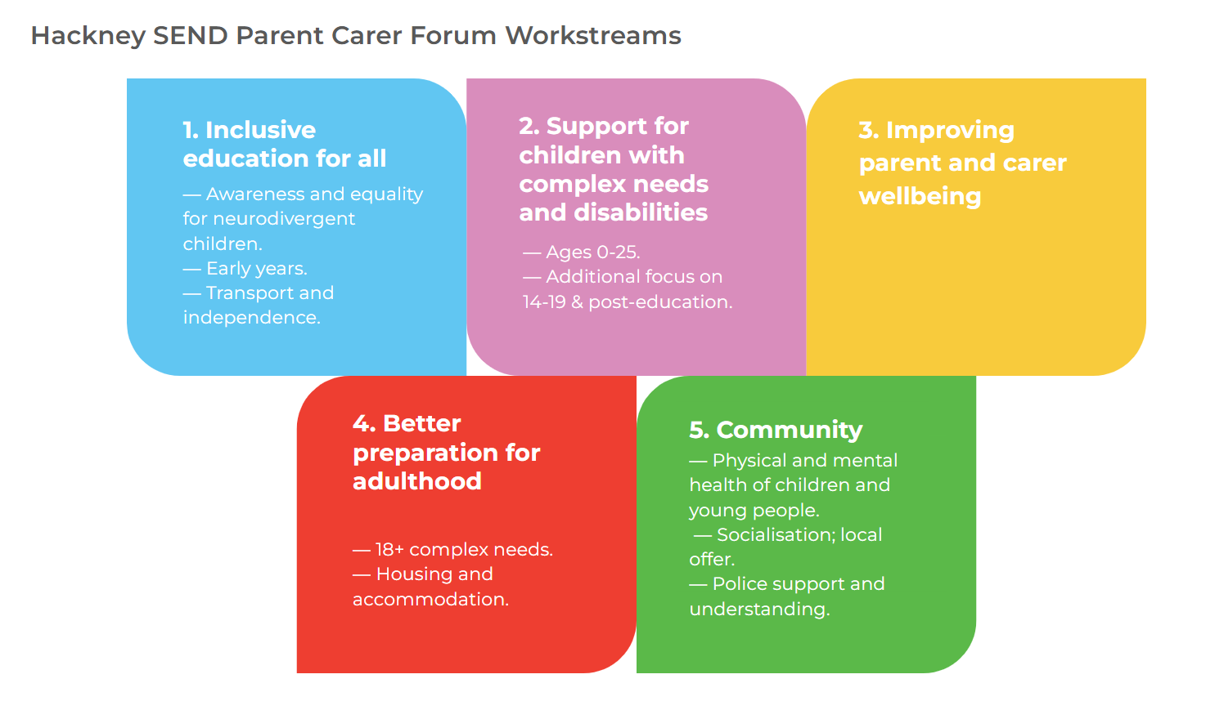
Focus Areas
Notes:
Inclusive Education
Complex Needs & Disabilities
Parent Carer Wellbeing
Community & Preparing for Adulthood
Preparing for Adulthood
Community & Connection

Slide 11
Inclusive Education for All
National influence: Parliament’s Solving the SEND Crisis Call for Evidence submission. Read our evidence here
PiNS – The Partnerships for Inclusion of Neurodiversity in Schools HSPCF worked with seven primary schools
SEND & Inclusion Strategy: HSPCF took part in a workshop with Hackney’s Director of Education on the draft three-year SEND & Inclusion Strategy.
EHCP webinar: 5 June with SENDIAGS and the local authority, recording, slides and Q&A responses
System improvement: Participation in appointment process for a new Head at New Regent College (Alternative Provision)
School transport: trial of the new school transport application process
Looking ahead: Response to 2025 SEND Inspection Report
Notes:
National influence: HSPCF submitted evidence for the Parliament’s Solving the SEND Crisis Call for Evidence – the final report was published on 18th September. Read our evidence here
PiNS – The Partnerships for Inclusion of Neurodiversity in Schools (PINS): in the last academic year, HSPCF worked with seven primary schools, running coffee mornings and wellbeing sessions to engage parents and carers and introduce the PINS programme and local support.
School engagement: This year, our team of three parent carers is working with six primary schools to help school teams better understand what families need for children with SEND to thrive, while offering parents information and practical support.
Looking ahead: In early 2026, HSPCF plans to expand wellbeing sessions in schools and work with Hackney Education on a booklet to support parents of neurodiverse children.
SEND & Inclusion Strategy: HSPCF took part in a workshop with Hackney’s Director of Education on the draft three-year SEND & Inclusion Strategy. Discussions supported the strategy’s progressive direction and highlighted the importance of parent involvement in evaluating progress.
EHCP webinar: Held on 5 June with SENDIAGS and the local authority, with wide attendance and many questions. The recording, slides and Q&A responses are available.
System improvement: HSPCF was involved in the appointment process for a new Head at New Regent College (Alternative Provision) and contributed to the trial of the new school transport application process, from questionnaire design to focus groups.

Slide 12
Complex needs and Disabilities
Focus: Meeting with council and health needs
Links: Hackney Ark and NHS Integrated Care Board meetings
Expert input: Autism Experts with Penny Heron
Looking ahead: active focus group and dedicated event

Slide 13
Parent Carer Wellbeing
CAMHS parent support talk: research on support for families
Coffee Mornings: 6 sessions
Looking Ahead: Healthy Parent Carer Programme: courses on wellbeing and stress management throughout the year

Slide 14
Community
Housing and Rights: Workshop with Shelter for 40 carers
Family Fun Day: ~80 participants
Festive Celebration: 25 carers
Local Offer: engagement and dissemination
Looking ahead: Behaviour Scrutiny Commission Input https://consultation.hackney.gov.uk/children-education/behaviour-inclusion-call-for-evidence/

Slide 15
PfA
PfA Delivery Group recommendations
PfA Future Ready Event: engagement and participation
Feedback Suggestions: Education, Employment, Benefits and Independent living improvements
Supported Internships talk
Looking Ahead Proposals include:
  Annual co-design workshops
  Engagement mapping and opportunities for the year including parents and young people involvement
  Named HSPCF representation at Delivery Group meetings
  Task and finish groups
  Engagement & Reporting back to parents
Notes:
E.g.: Impact of merger between B6 and NCC reducing available provision

Slide 16
Your recent contributions
Surveys and forums:
Local Area SEND inspection
SEND & Inclusion Strategy consultation
SEND strategy survey
Three-year education plan survey
Parliament’s Solving the SEND Crisis call for evidence

Slide 17
Looking Ahead
Priorities include
Increase participation in focus areas and beyond
Inspection Report 11th February parent discussion
Education Strategy follow-up
Behaviour Scrutiny Commission updates
PfA - engagement and co-production
Complex needs
Early Years
Notes:
Active Participation:
Hackney SEND Parent Carer Forum will continue its active and consistent attendance at Preparing for Adulthood Delivery Group meetings. Through this ongoing involvement, Hackney SEND Parent Carer Forum will contribute parent and carer perspectives to discussions, help identify gaps in current provision and support the development of services that enable positive adulthood outcomes for young people with SEND, including Education, Training, Employment, Independent living, Community inclusion, Health and Wellbeing.
Strengthening Engagement:
Hackney SEND Parent Carer Forum has been invited to advise on a range of engagement opportunities aimed at strengthening collaborative and inclusive working across partner organisations. This includes supporting partners to reach a broader and more diverse group of parents and carers, improving communication channels, and ensuring engagement approaches are accessible, meaningful and responsive to the needs of families. The forum’s role will help ensure that engagement is not tokenistic but leads to shared understanding and improved joint working.
Commitment to Co-production:
There is a strong and shared commitment to co-production, with an emphasis on involving parents and carers from the earliest stages of planning and decision-making. A formal proposal has been submitted for the PfA Delivery Group to work in co-production with HSPCF, embedding lived experience at the heart of service design, delivery and review. This approach aims to ensure that PfA services are shaped by what matters most to families, leading to more effective, inclusive, and sustainable outcomes for young people with SEND

Slide 18
Your feedback
Breakout Group discussion:
Issues encountered
Systemic problems
Suggestions for improvement
Your participation

Slide 19
Recap
Key issues raised
How representation works
Volunteer opportunities
Next steps
Notes:
Review feedback form!!!

Slide 20
Recap
T H A N K Y O U
Notes:
Review feedback form!!!

